Slide 1
KMOU Division of Marine System Engineering
Introduction to
Internal Combustion Engine

Slide 2
Lesson content for each week
Ch0_Introduction to the Class | Ch6_Piston Fittings and Crankshaft
Ch1_Overview of the Internal Combustion Engine | Ch7_Lube Oil System
Ch2_Thermodynamics and Compressed Air System | Ch8_Cooling Water System
Ch3_Marine Fuels and Internal Fuel Oil System | Ch9_Introduction to the Main Engine
Ch4_Intake and Exhaust System | Ch10_Alternative Fuels and Alternative Fuel Systems
Ch5_Turbocharger | Ch11_Environmental Regulations and Exhaust Gas Aftertreatment Systems
Midterm | Ch12_Tools, Apprentice Engineer Duties, and Career Direction
 | Final Exam

Slide 3
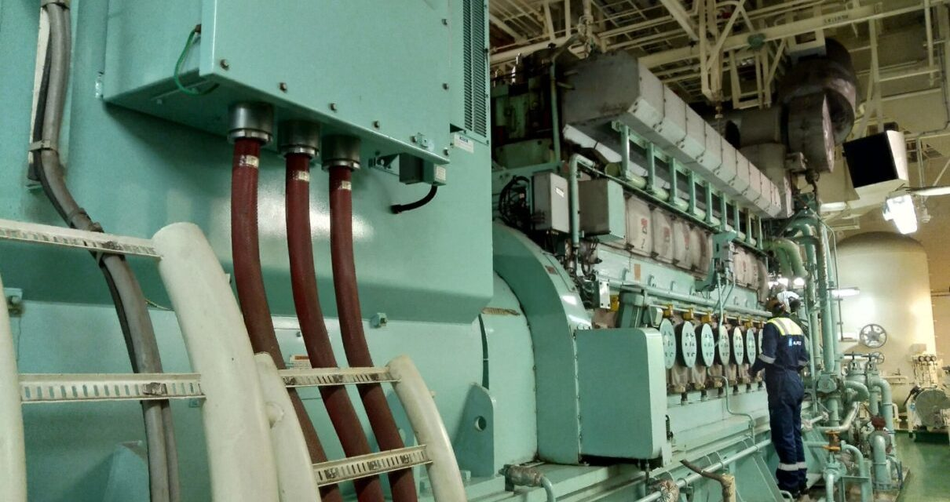
4-stroke ICE (G/E)
Inside the G/E cylinder, atomized fuel injected from the fuel injection nozzle and pressurized air supplied by the turbocharger are mixed and exploded, pushing the piston downward to reciprocate and generate rotational power.
The goal of this chapter is to learn about the fuel used on ships and the fuel supply system.

Slide 4
Marine fuels
The fuels typically used on ships are as follows:
HFO : Heavy Fuel Oil
VLSFO : Very Low Sulfur (Sulphur) Fuel Oil
MDO : Marine Diesel Oil
MGO : Marine Gas Oil
LSMGO : Low Sulfur Marine Gas Oil

Slide 5
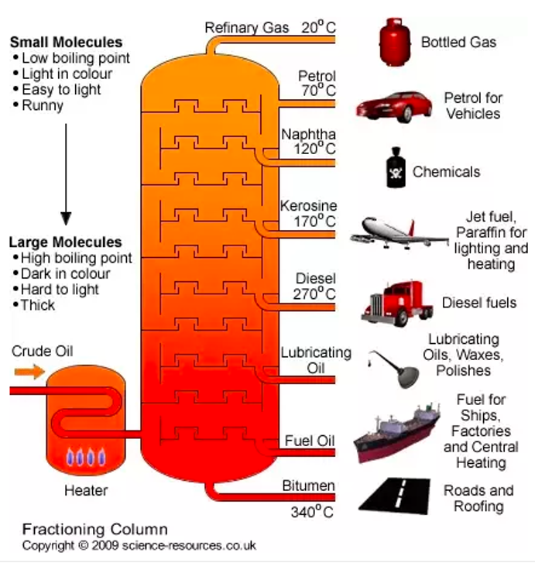
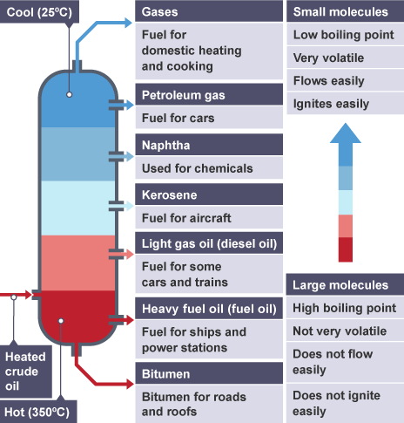
Marine fuels
Fractional distillation of crude oil
Fractional distillation of crude oil
Notes:
Remnant: : 남은 부분, 나머지
Fractional Distillation : 분별 증류(액체 혼합물을 가열하여 각각의 성분을 분리해 내는 방법)

Slide 6
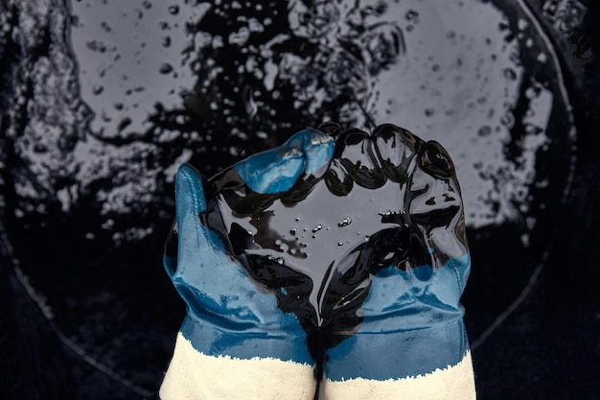
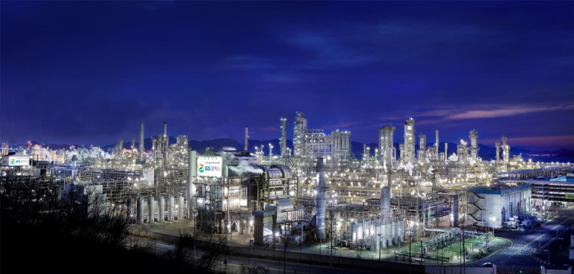
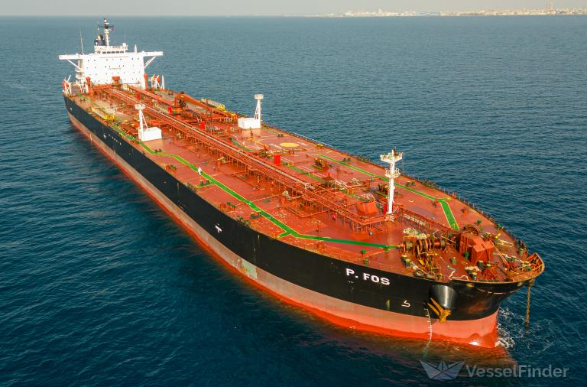
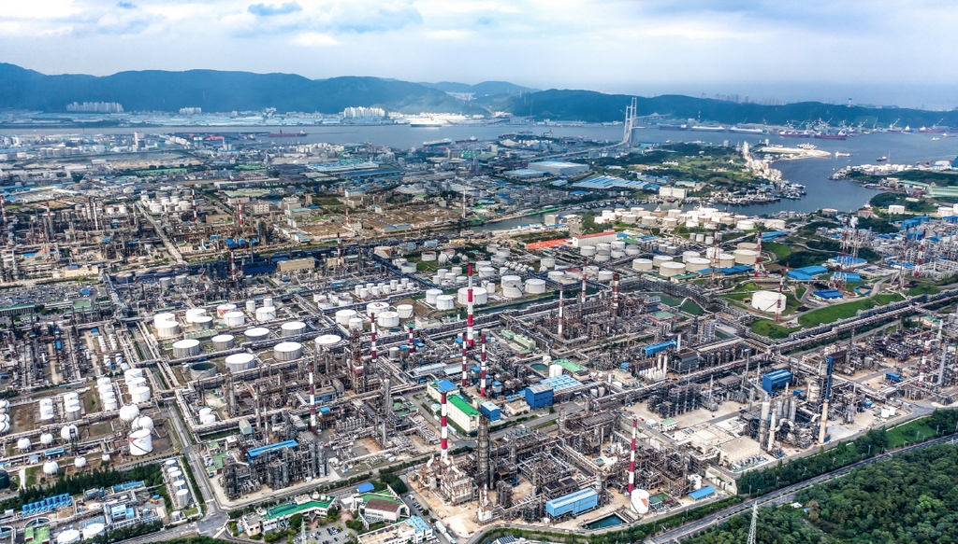
Marine fuels
Crude oil
Yeosu complex
Crude oil tanker
Ulsan complex

Slide 7
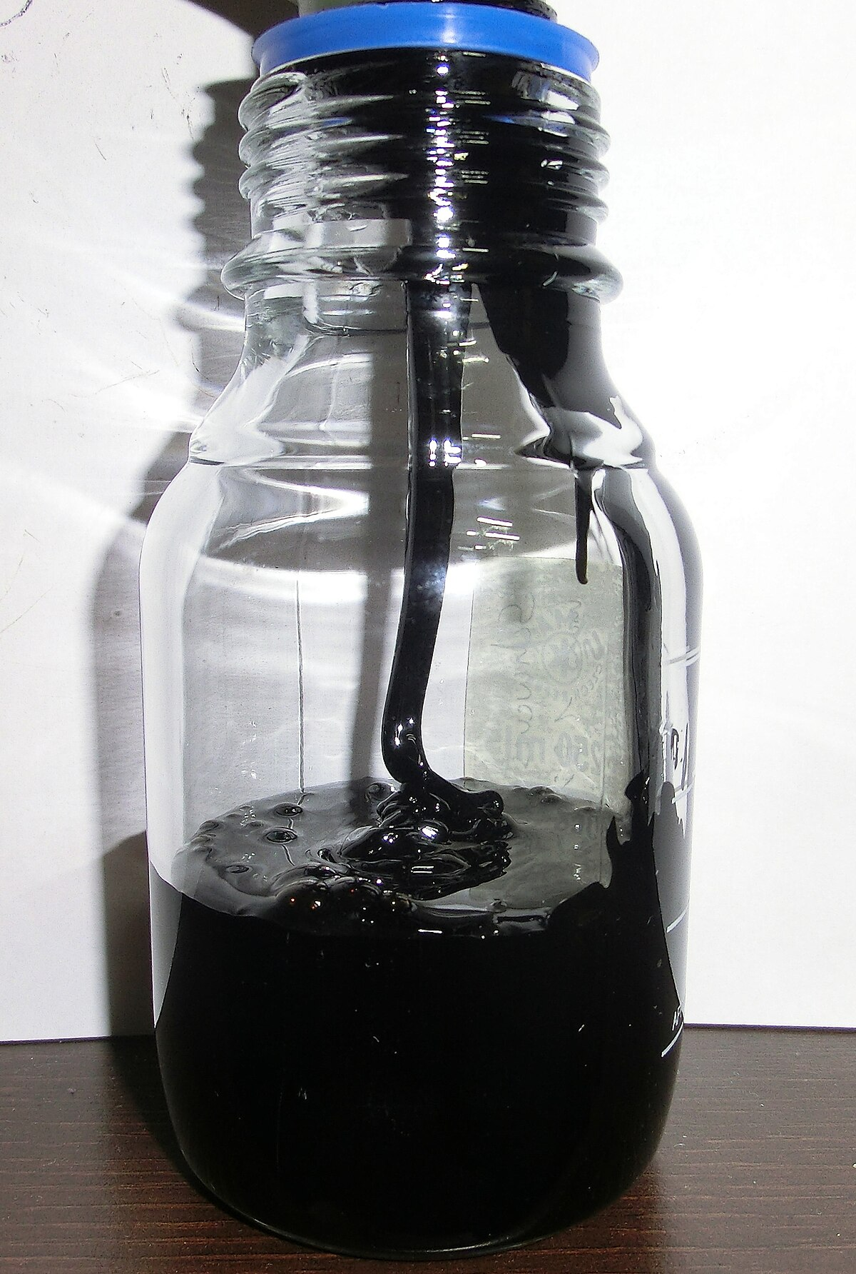
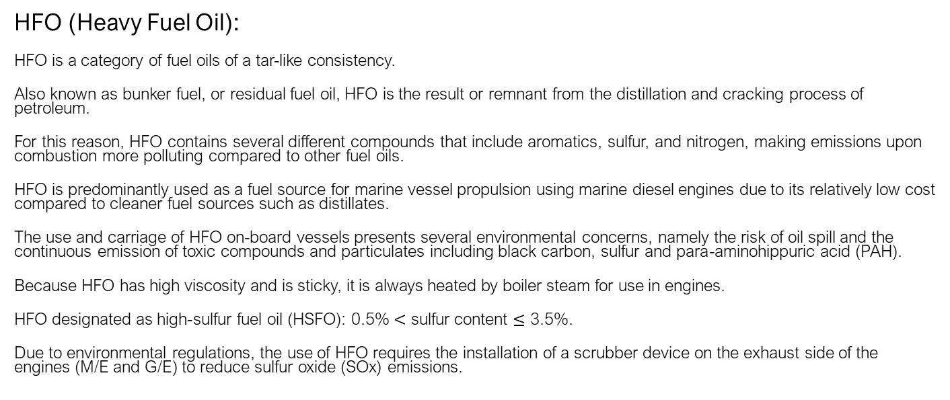
Marine fuels
HFO (Heavy Fuel Oil):
HFO is a category of fuel oils of a tar-like consistency.
Also known as bunker fuel, or residual fuel oil, HFO is the result or remnant from the distillation and cracking process of petroleum.
For this reason, HFO contains several different compounds that include aromatics, sulfur, and nitrogen, making emissions upon combustion more polluting compared to other fuel oils.
HFO is predominantly used as a fuel source for marine vessel propulsion using marine diesel engines due to its relatively low cost compared to cleaner fuel sources such as distillates.
The use and carriage of HFO on-board vessels presents several environmental concerns, namely the risk of oil spill and the continuous emission of toxic compounds and particulates including black carbon, sulfur and para-aminohippuric acid (PAH).
Because HFO has high viscosity and is sticky, it is always heated by boiler steam for use in engines.
HFO designated as high-sulfur fuel oil (HSFO): 0.5% $<$ sulfur content $≤$ 3.5%.
Due to environmental regulations, the use of HFO requires the installation of a scrubber device on the exhaust side of the engines (M/E and G/E) to reduce sulfur oxide (SOx) emissions.
Notes:
Consistency: 농도
Residual: 남은, 잔여의
Remnant: 남은 부분
Aromatics: 방향성 물질
Predominantly: 대부분
Particulate: 입자성 물질

Slide 8
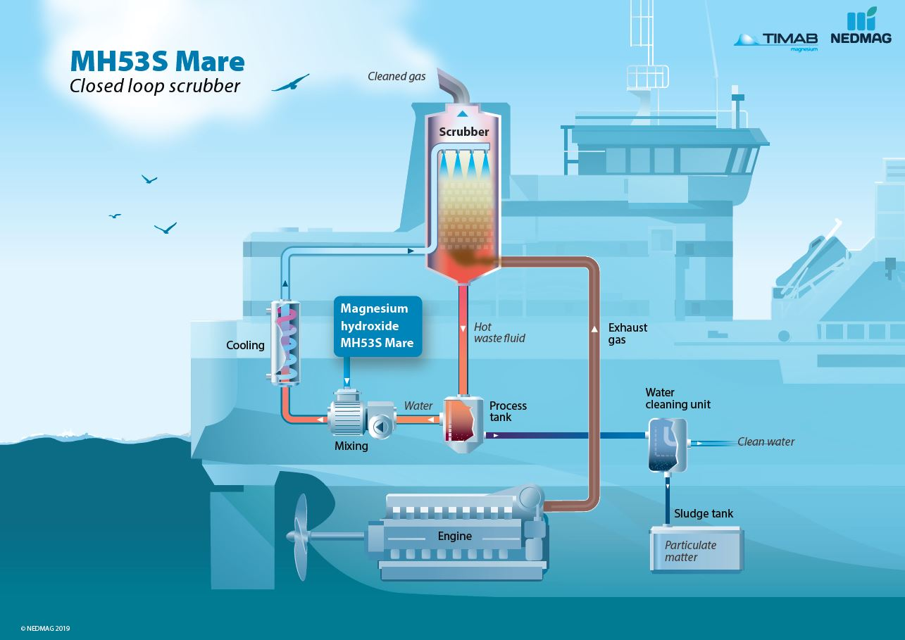
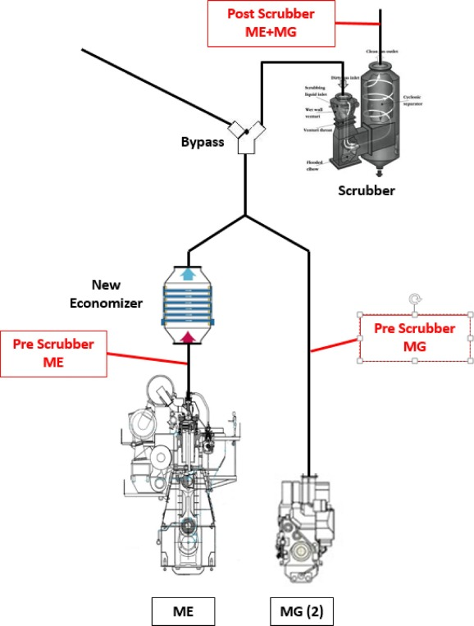
Scrubber

Slide 9
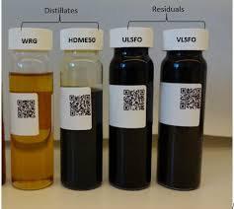
Marine fuels
VLSFO (Very Low Sulfur Fuel Oil):
VLSFO is a type of fuel oil with a sulfur content of 0.5% or less by weight.
The creation of VLSFO was primarily driven by the International Maritime Organization’s (IMO) regulation, known as IMO 2020, which mandated a hefty reduction in the sulfur content of ship fuels from 3.5% to 0.5% starting January 1, 2020.
This regulation aims to decrease the amount of sulfur oxide emissions from ships.
VLSFO has become the preferred choice for many due to its lower fuel cost compared to MGO and less complex implementation compared to fitting scrubbers.
Ultra Low Sulphur Fuel Oil (ULSFO) are fuels with a sulfur content not exceeding 0.10% S.

Slide 10
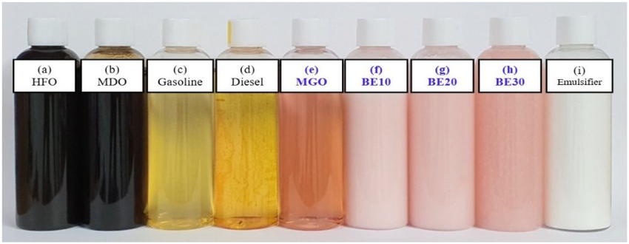
Marine fuels
MDO (Marine Diesel Oil):
MDO is a type of fuel oil and is a blend of gasoil and HFO.
MDO is also called distillate marine diesel.
MDO does not need to be preheated before using, while HFO and VLSFO need to be preheated.
MGO is increasingly being used instead of MDO for use in areas (SECA: Sulfur Emission Control Area) subject to sulfur content regulations.

Slide 11
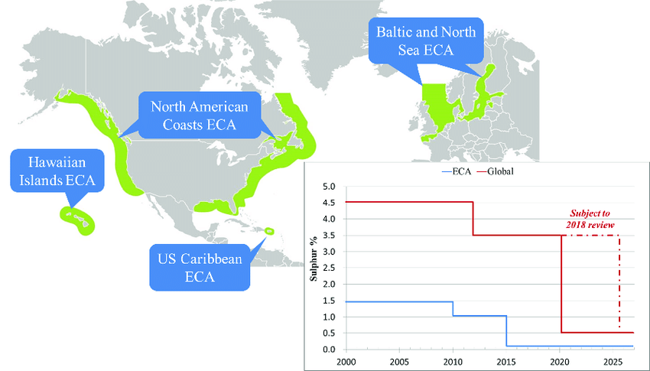
Marine fuels
SECA: Sulfur Emission Control Area
0.1%

Slide 12
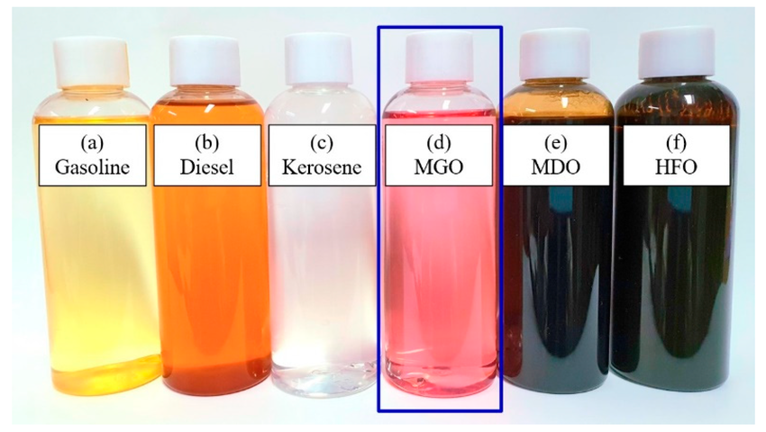
Marine fuels
MGO (Marine Gas Oil):
MGO refers to marine fuels that consist solely of distillates, the components of crude oil that evaporate in fractional distillation and are then condensed from the gas phase into liquid fractions.
Distillates are all those components of crude oil that evaporate in fractional distillation and are then condensed from the gas phase into liquid fractions. MGO usually consists of a blend of various distillates.
MGO is similar to diesel but has a higher density, and unlike HFO, MGO doesn’t require heating during storage.
Notes:
Fractional distillation: 분별 증류

Slide 13
Marine fuels
LSMGO (Low Sulfur Marine Gas Oil):
MGO is produced with varying degrees of sulfur content, though the maximum permissible sulfur content of MGO lies below that of HFO.
LSMGO has a sulfur content of less than 0.1%.
This marine fuel can be used in EU ports or Emission Control Areas (ECAs), which among other things impose a sulfur emissions limit corresponding to that of LSMGO.
For this reason, most shipping companies use a LSMGO in these places.

Slide 14
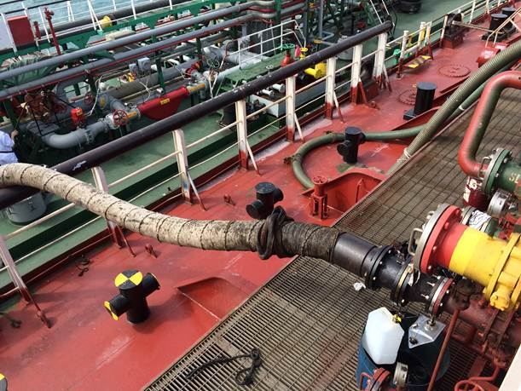
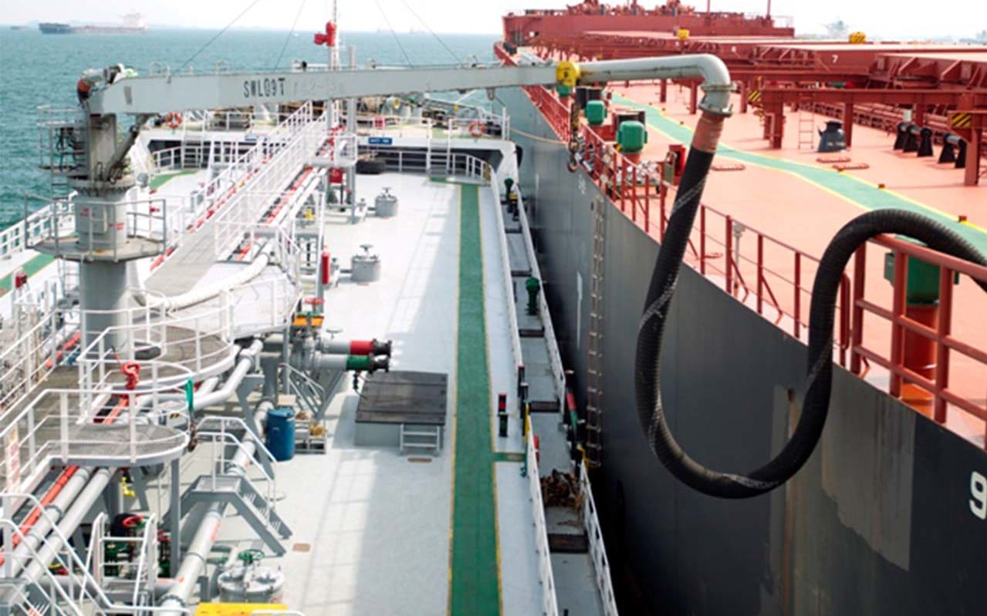
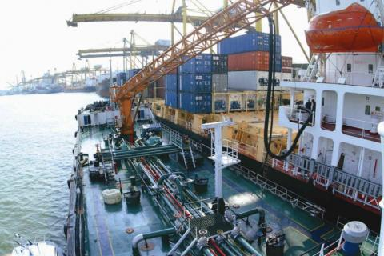
Marine fuels
Bunkering manifold
Hose from bunker barge
How is marine fuel loaded onto a ship? (This is called bunkering)
1) Bunker Barge (Most ships receive their fuel from bunker barges
to load large quantities of fuel onto the ship.)
Container ship
Bunker barge
Bunker barge
Bulk carrier

Slide 15
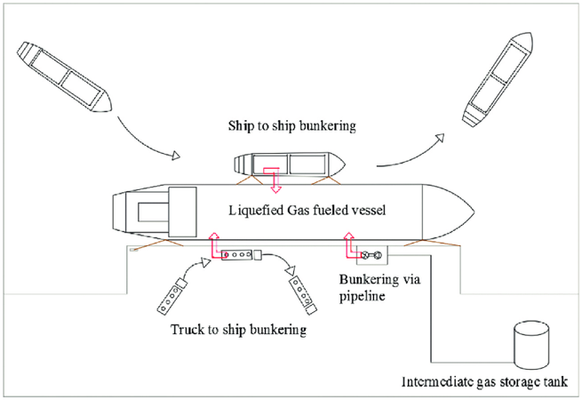
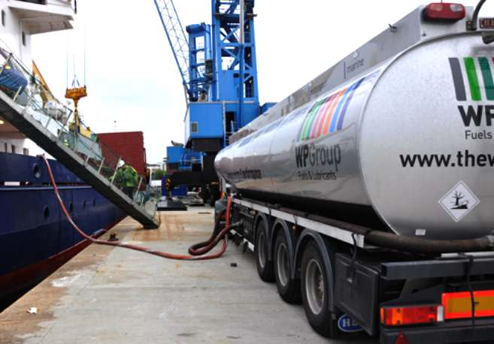
Marine fuels
How is marine fuel loaded onto a ship?
2) Tank Lorry (Tank lorries can be used when supplying MGO to ships in small quantities. However, in most cases, all fuel is supplied by bunker barges. Tank Lorries are mostly used to supply lubricants.)

Slide 16
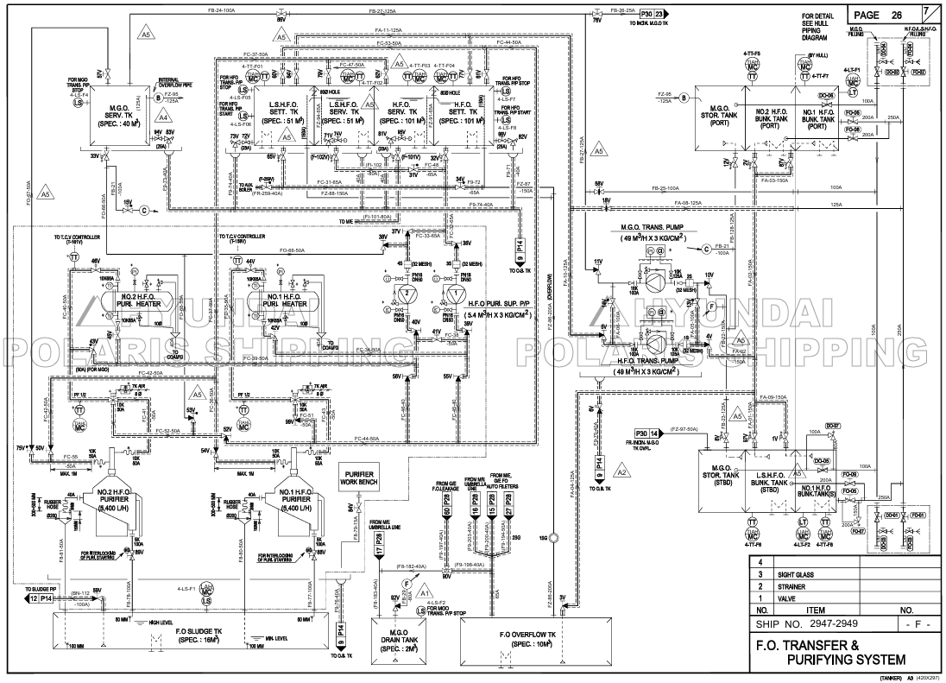

Slide 17
Fuel supplied from the bunker barge is stored in oil storage tanks (H.F.O. tank or M.G.O tank) from the bunker manifold.
: F.O.
: M.G.O.

Slide 18
The oil in the H.F.O. tank is sent to the H.F.O. settling tank by the H.F.O. transfer pump.
: F.O.

Slide 19
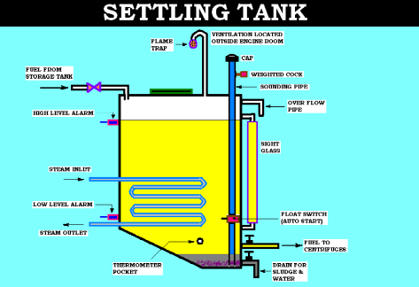
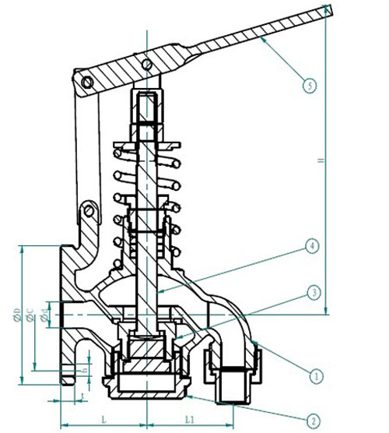
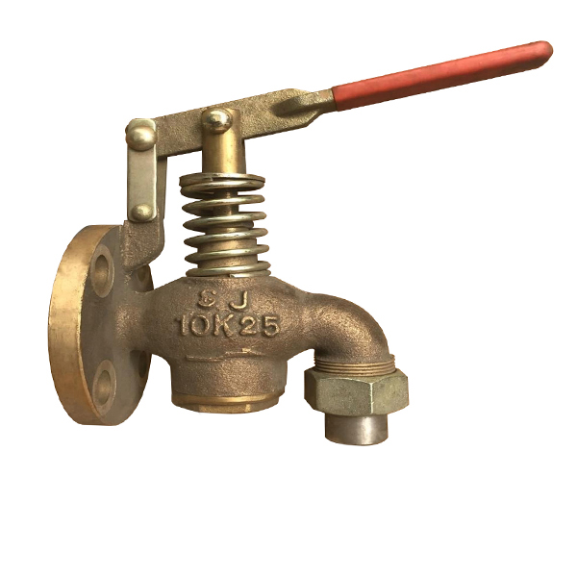
Drain for F.O. tanks
Since sludge and water accumulate at the bottom of every FO tank, apprentice engineers usually drain it twice a day.

Slide 20
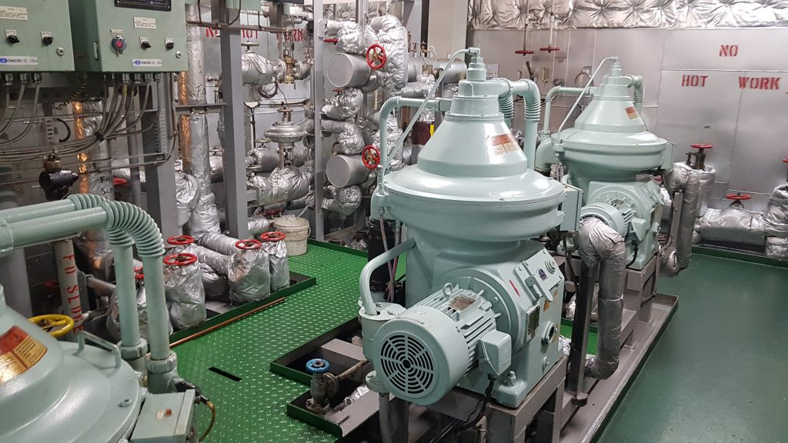
The oil in the H.F.O. sett. tank is purified by the H.F.O. purifier and then sent to the H.F.O. serv. tank.
: H.F.O.
: L.S.H.F.O.
: Common

Slide 21
Since MGO does not need to be purified, it is sent from the M.G.O. stor. tank to the M.G.O. serv. tank by the M.G.O. trans. pump.

Slide 22
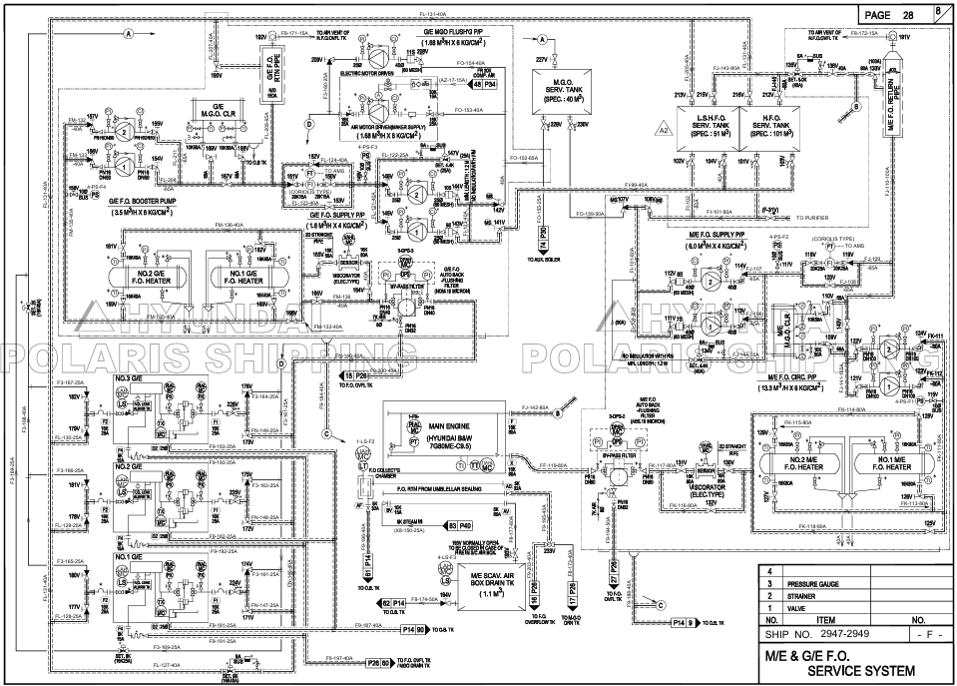

Slide 23
HFO or LSHFO reaches the G/E inlet from the
1) service tank through the
2) G/E F.O. supply pump,
3) Flowmeter,
4) G/E F.O. booster pump,
5) G/E F.O. heater, 6) Viscorator,
7) G/E F.O. auto back-flushing filter.
: H.F.O.
: L.S.H.F.O.
: Common

Slide 24
MGO reaches the G/E inlet from the
1) service tank through the
2) G/E F.O. supply pump,
3) Flowmeter,
4) G/E M.G.O. cooler,
5) G/E F.O. booster pump.
(G/E F.O. auto back-flushing filter is turned off or by-passed.)
: M.G.O.

Slide 25
MGO reaches the G/E inlet from the 1) service tank through the
2) G/E M.G.O. flushing pump.
When using a G/E M.G.O. flushing pump, the purpose is to flush only the specific G/E with M.G.O. for reasons such as long-term maintenance, while other G/Es are operated with H.F.O.
: M.G.O.

Slide 26
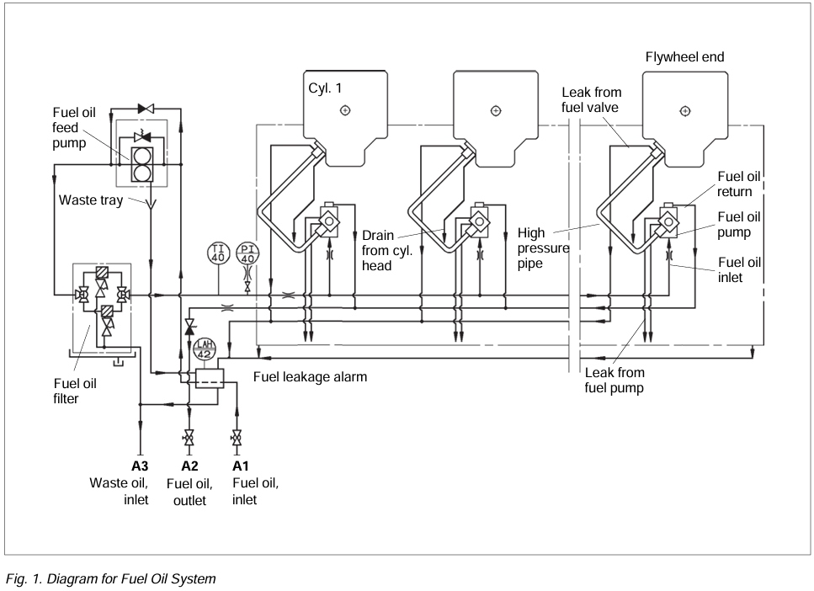
Internal Fuel Oil System for G/E (MAN B&W)

Slide 27
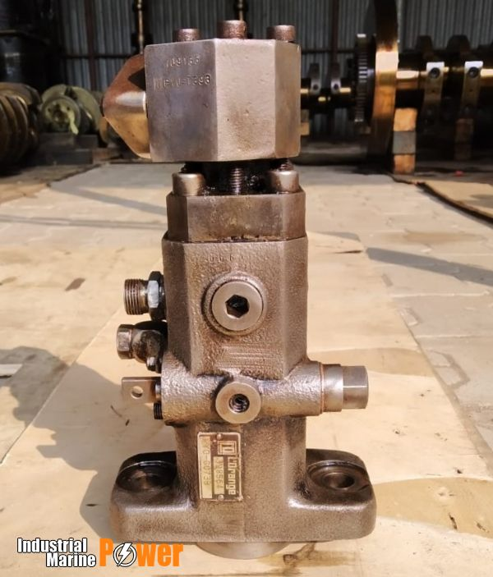
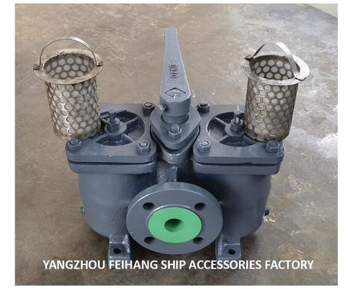
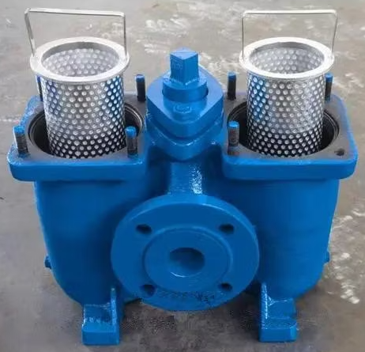
Internal Fuel Oil System for G/E (MAN B&W)
Fuel oil filter
The oil that reaches the G/E inlet is pressurized by the engine driven fuel oil feed pump and then passes through the fuel oil filter to reach the fuel oil pump.
(The fuel oil filter is also called as “duplex filter/strainer”.)

Slide 28
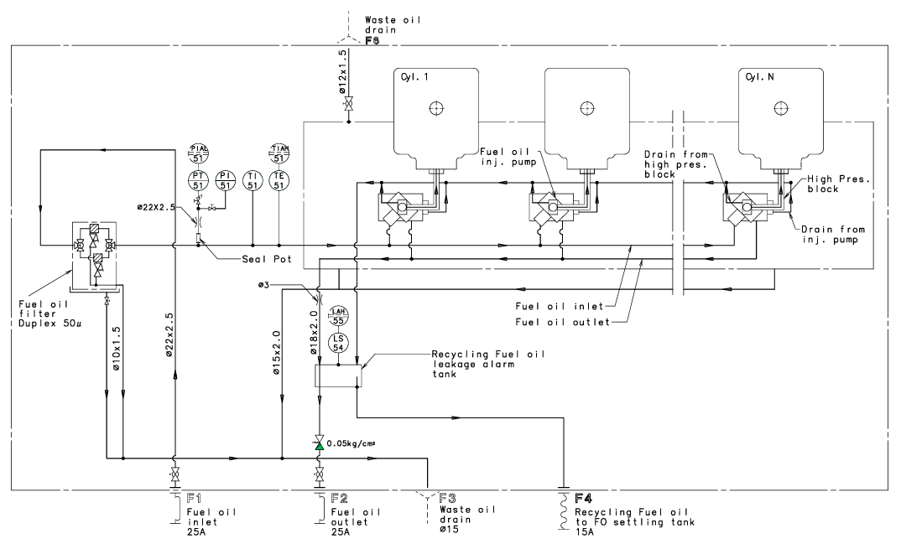
Diagram for the internal fuel oil system for G/E (HiMSEN)
The fuel oil feed pump is not installed in the HiMSEN engine.

Slide 29
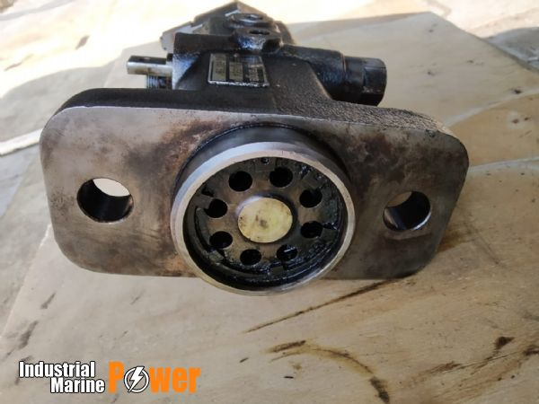
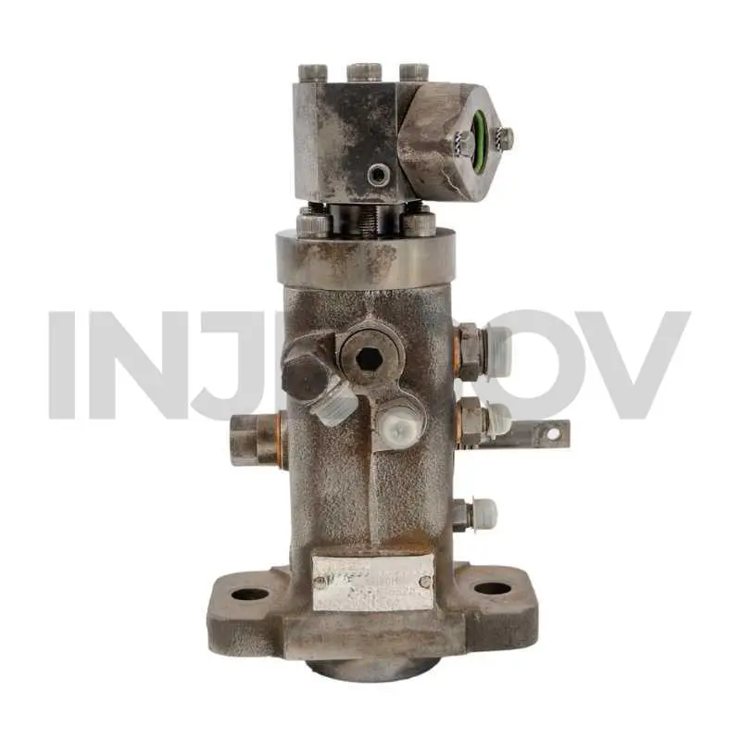
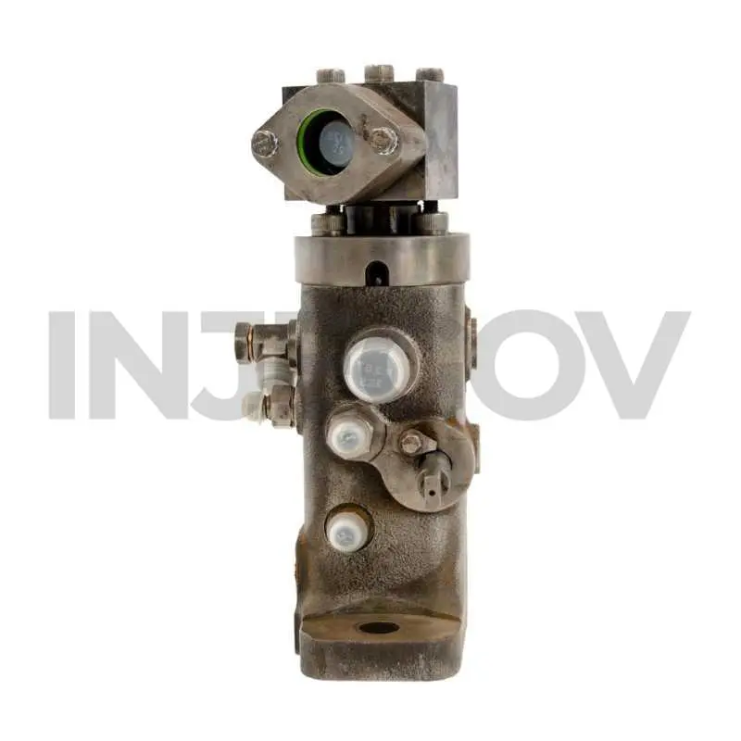
Fuel injection pump (MAN B&W)
The photos below are actual photos of the
fuel injection pump taken from various angles.

Slide 30
Fuel injection pump (MAN B&W)
YouTube videos can be useful for understanding the structure of fuel injection pumps.
Various videos are available on YouTube, so please search for them.

Slide 31

Fuel injection pump (MAN B&W)

Slide 32
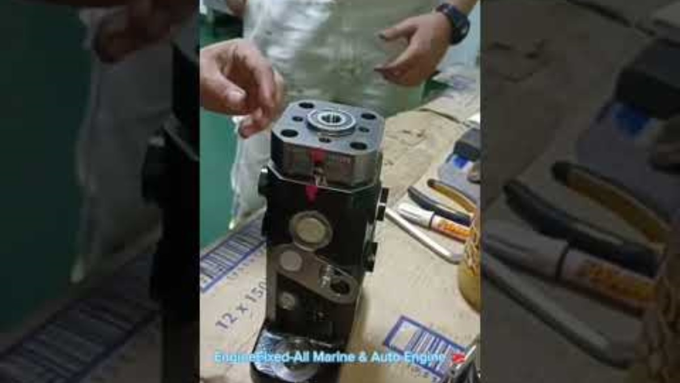
Fuel injection pump (MAN B&W)

Slide 33
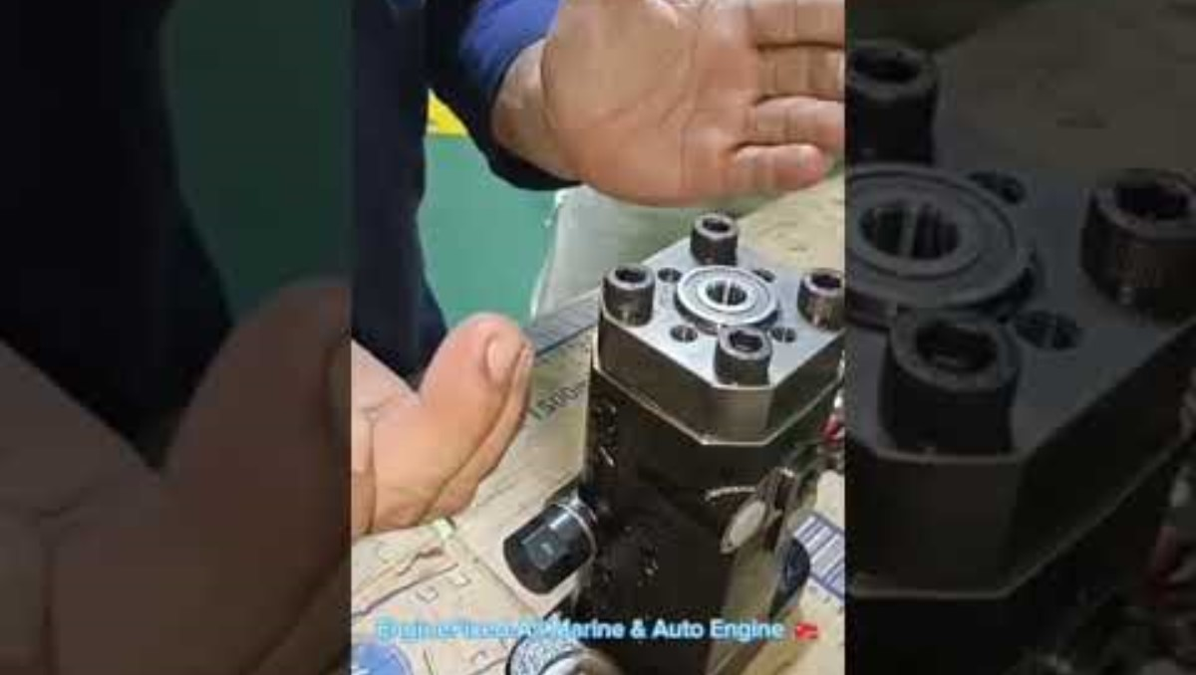
Fuel injection pump (MAN B&W)

Slide 34
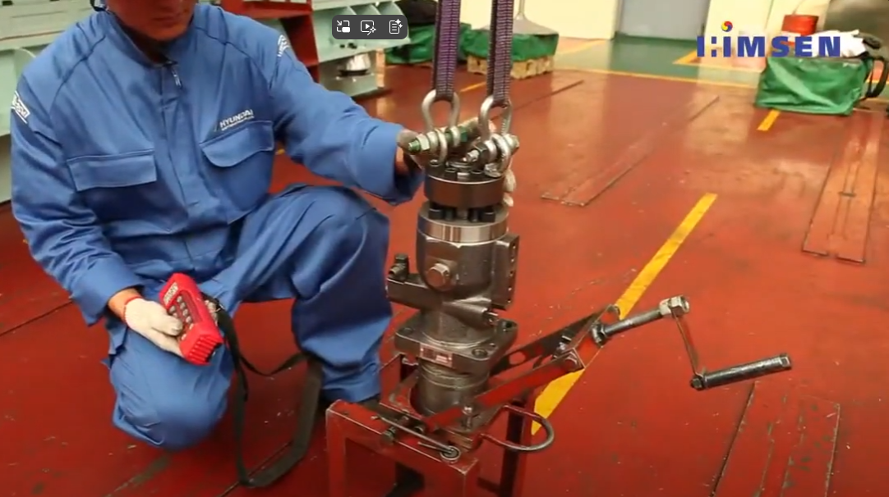
Fuel injection pump (HiMSEN)
The fuel injection pump of the HiMSEN engine is much larger (also heavy) and looks slightly different than the fuel injection pump of the MAN B&W, but the operating mechanism is the same.
YouTube can be referenced to understand the fuel injection pump of the HiMSEN engine.

Slide 35
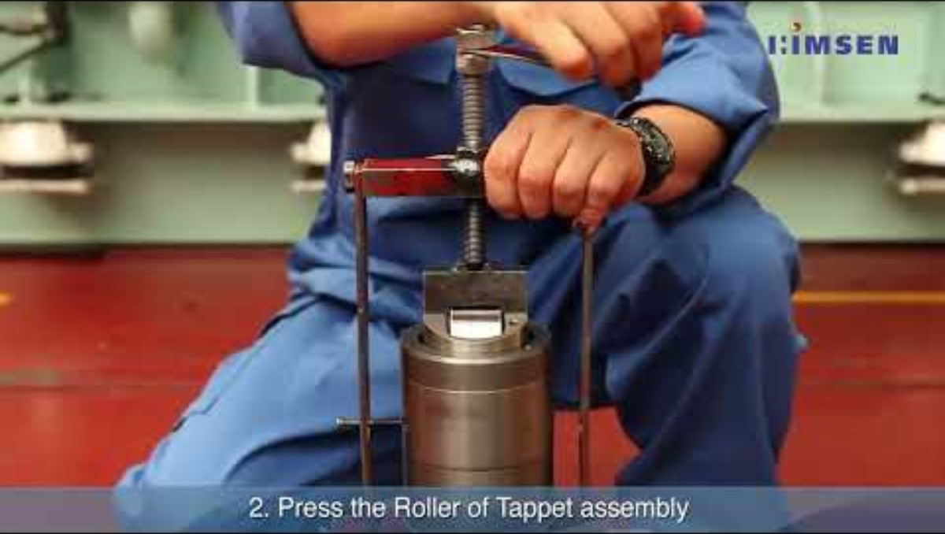
Fuel injection pump (HiMSEN)

Slide 36
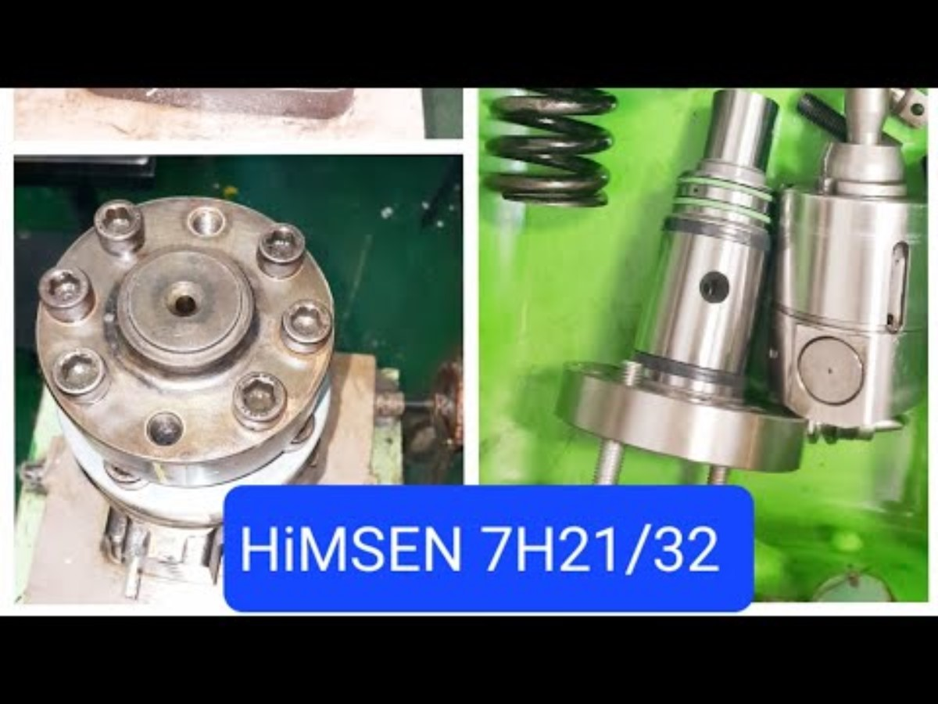
Fuel injection pump (HiMSEN)

Slide 37
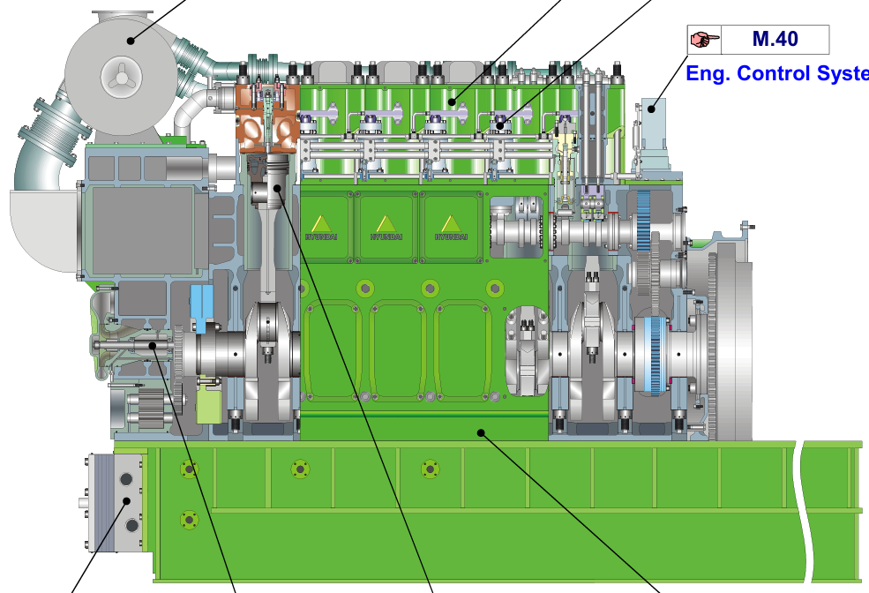
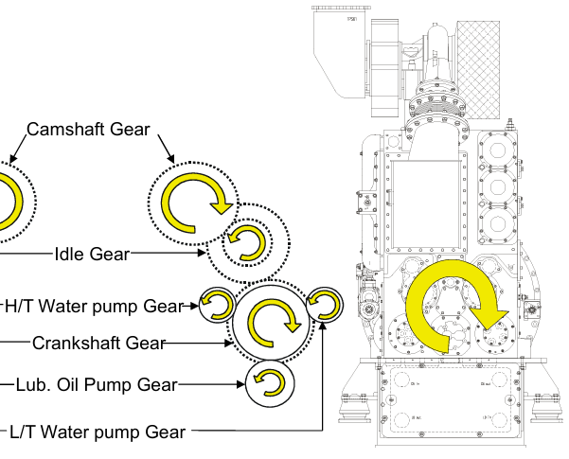
Fuel injection pump (HiMSEN)
The fuel injection pump is installed above the camshaft, and it is activated by the cam on the camshaft.
Camshaft
Crank
shaft

Slide 38
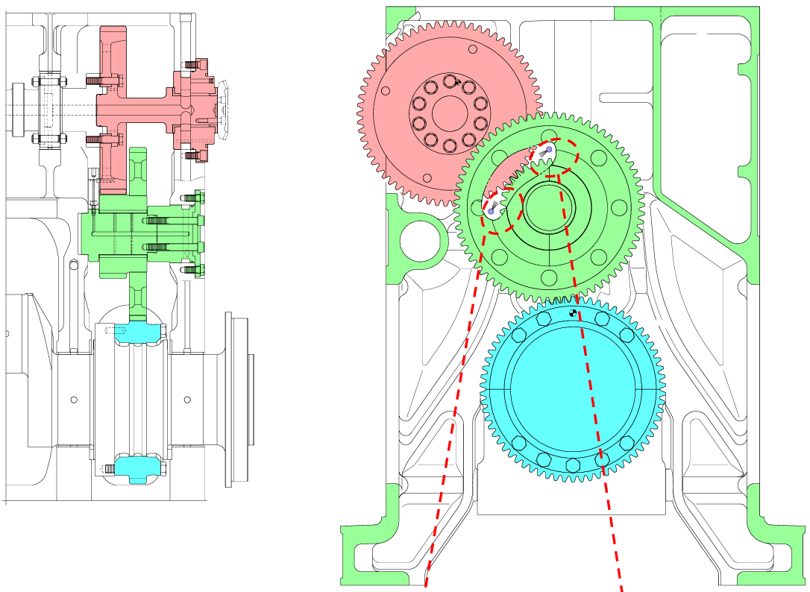
Fuel injection pump (HiMSEN)
The fuel injection pump is installed above the camshaft, and it is activated by the cam on the camshaft.

Slide 39
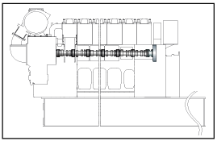
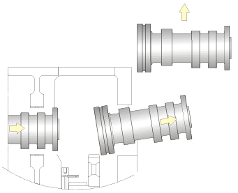
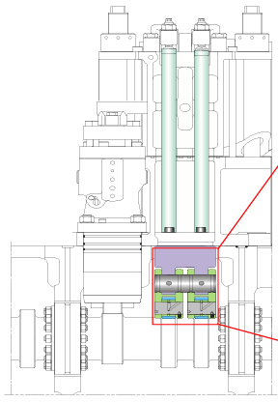
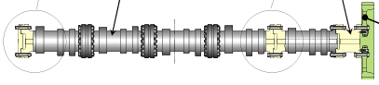
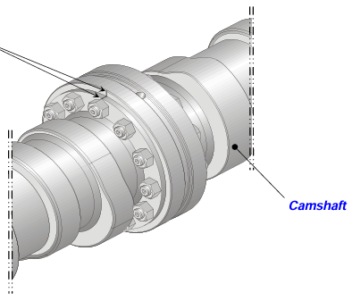
Fuel injection pump (HiMSEN)
The fuel injection pump is installed above the camshaft,
and it is activated by the cam on the camshaft.
Camshaft
Fuel injection pump
The camshaft piece can be disassembled to replace the camshaft itself or the bearing shells for the camshaft.
Cam for fuel injection pump
Cam for rocker arm
Cam for fuel injection pump

Slide 40
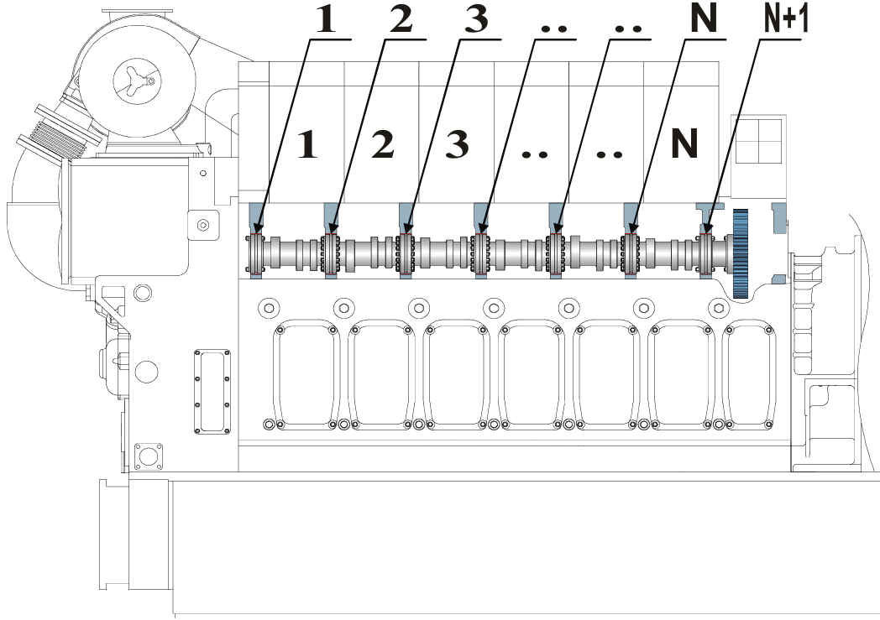
Camshaft (HiMSEN)

Slide 41
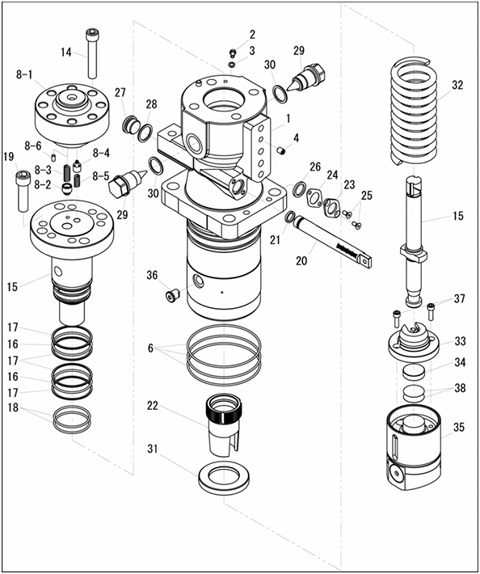
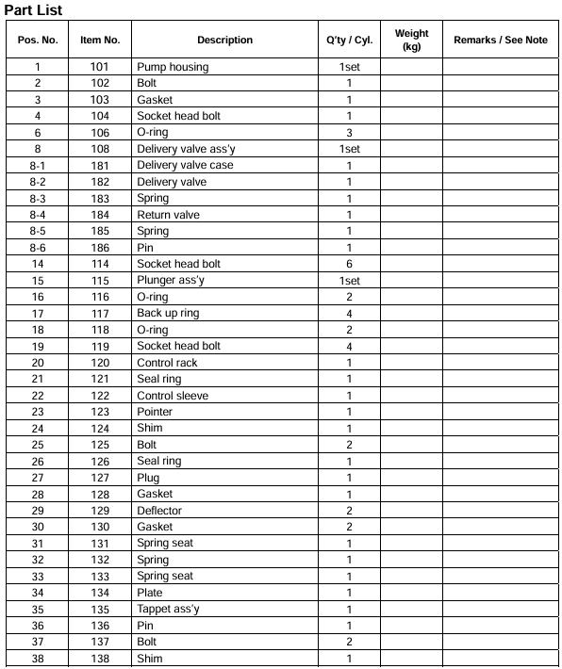

Fuel injection pump (HiMSEN)
Plunger
Barrel
Rack (also called as fuel rack)
Sleeve

Slide 42




Fuel injection pump (MAN B&W)
The fuel injection pump is installed on the roller guide housing directly above the camshaft, and it is activated by the cam on the camshaft through roller guides fitted in the roller guide housing.
Roller guide for
valve gear (Not for this chapter)
Roller guide
Cam for fuel injection pump
Roller guide for
fuel injection pump
Roller

Slide 43


Fuel injection pump (MAN B&W)
Barrel
Gear rim
Plunger
Regulating rod

Slide 44



Fuel injection pump
The injection amount of the pump is regulated by transversal displacement of a toothed rack in the side of the pump housing. The plunger, which is fixed to the gear rim, rotates as the regulating rod (fuel rack) moves back and forth. As the plunger rotates, the amount of oil flowing out through the spillport changes, and accordingly, the amount of pressurized oil flowing to the outlet (to the high pressure pipe then fuel injection valve) changes.
Notes:
Transversal : 횡단하는
Displacement : 이동

Slide 45



Fuel injection pump
The plunger performs reciprocating motion by the cam on the camshaft.
Outlet to high pressure pipe and fuel injection valve
Inlet
Spillport

Slide 46

Fuel injection pump

Slide 47

Fuel injection pump (HiMSEN)
Adjustment of fuel injection timing
Fuel injection timing influences the maximum cylinder pressure which is set properly by engine maker and normally recommended not to be adjusted.
However, if new fuel injection pump has been installed or if the deviation of each cylinder pressure is out of tolerance, the injection timing should be checked and adjusted, which can be adjusted by the thickness of thrust plate as shown in fig 1.
When inserting thrust plate (increasing thickness), the injection timing advanced and maximum cylinder pressure increased.
Thrust plate thickness + 0.1mm = Cyl. pressure + 2 bar

Slide 48





Fuel injection pump (HiMSEN) & Govenor
Governor
linkage
assembly
The fuel racks of all fuel injection pumps are connected to a common regulating shaft and spring-loaded linkages.
Fuel injection pump
Governor
Fuel rack
Fuel rack

Slide 49

Govenor

Slide 50

Fuel injection pump (HiMSEN) & Govenor
Depending on the fuel injection pump, fuel may not be injected into the cylinder when the fuel rack is pulled in, or fuel may not be injected into the cylinder when the fuel rack is pushed in.

Slide 51


Fuel injection pump & Govenor
Governor

Slide 52


Fuel injection pump & Govenor
Fuel rack
Fuel injection pump

Slide 53

Fuel injection pump & Govenor

Slide 54

Fuel injection pump & Govenor

Slide 55


Fuel injection pump (HiMSEN) & Govenor
Engine Stop System
The engine is stopped when pressing ‘STOP’ button or ‘EMERGENCY STOP’ button on control panel intentionally, or by ‘AUTO STOP’ signal.
Engine automation system generate ‘AUTO STOP’ signal when abnormal condition of the engine is detected.
However, the engine is stopped fundamentally when the fuel injection into the combustion chamber is stopped. This means that the rack of each fuel injection pump is moved to stop position by stop signal. Every fuel rack is connected to common control shaft mechanically and also connected to common compressed air line pneumatically.

Slide 56
Fuel injection pump (HiMSEN) & Govenor
Engine Stop System
Therefore, there are two ways of moving fuel racks to stop position (Zero index) as shown in fig 2.
The one is by the mechanical stop, which pull the racks to stop position by the governor or the manual control lever. ‘STOP’ button activates the governor to be ‘STOP’ position.
The other is by the pneumatic stop by compressed air, which pushes the rack to stop position regardless of the governor control. ‘EMERGENCY STOP’ button or ‘AUTO STOP’ signals activates the stop solenoid valve to supply the compressed air for all fuel injection pumps. This ‘EMERGENCY STOP’ signal also activates governor’s stop simultaneously.

Slide 57

Lambda cylinder
Lambda cylinder
lambda cylinder is located near the governor linkage assembly and prevents excessive fuel from being injected into the cylinder during G/E initial start.
When the G/E overspeeds, compressed air is sent to the lambda cylinder, which in turn restricts the fuel rack connected to the linkage assembly, thereby restricting fuel injection into the cylinder and preventing overspeed.

Slide 58


Overspeed device (just for reference)

Slide 59


Overspeed device (just for reference)

Slide 60

Lambda cylinder
Lambda cylinder
lambda cylinder is located near the governor linkage assembly and prevents excessive fuel from being injected into the cylinder during G/E initial start.
When the G/E overspeeds, compressed air is sent to the lambda cylinder, which in turn restricts the fuel rack connected to the linkage assembly, thereby restricting fuel injection into the cylinder and preventing overspeed.

Slide 61


Lambda cylinder
Lambda cylinder
As the load on the G/E increases, the pressure of the charging air increases, overcoming the spring force and lifting the piston, releasing the fuel injection restriction of the fuel rack.

Slide 62
Lambda cylinder
Lambda cylinder
The purpose with the lambda controller is to prevent injection of more fuel in the combustion chamber of an auxiliary engine on the ship, than can be burned during a momentary load increase. This is carried out by controlling the relation between the fuel index and the charge air pressure.
The Lambda controller is also used as stop cylinder.
Advantages of Lambda Controller
The lambda controller has the following advantages:
Reduction of visible smoke in case of sudden momentary load increases on auxiliary engines.
Improved load ability.
Less fouling of the engine’s exhaust gas ways.
Limitation of fuel oil index during starting procedure.

Slide 63
Lambda cylinder
Principle of Lambda Controller
In case of a momentary load increase, the regulating device will increase the index on the injection pumps and hereby the regulator arm (1) is turned, the switch (2) will touch the piston arm (3) and be pushed downwards, whereby the electrical circuit will be closed.
Thus, the solenoid valve (4) opens. The jet system is activated, the turbocharger accelerates and increases the charge air pressure, thereby pressing the piston (3) backwards in the lambda cylinder (5). When the lambda ratio is satisfactory, the jet system will be deactivated.
At a 50% load change the system will be activated for about 3-8 seconds.
If the system is activated more than 10 seconds, the solenoid valve will be shut off and there will be a remote signal alarm for “jet system failure”.

Slide 64
Lambda cylinder
Fuel oil limiting during start procedure
During the start procedure the lambda controller is used as an index limiter.
Hereby heavy smoke formation is prevented during start procedure and further the regulating device cannot over-react.
The jet system is blocked during the starting procedure until the engine has reached about 110 RPM.

Slide 65



Lambda cylinder

Slide 66

Lambda cylinder

Slide 67

Lambda cylinder

Slide 68


Fuel rack limiter ($≈$ Lambda cylinder)

Slide 69

Fuel rack limiter ($≈$ Lambda cylinder)
During starting period, the turbocharger is out of normal operation and therefore diesel engine is always in the incomplete combustion due to lack of air, which results in heavy smoke.
Digital governors have fuel limiting function for starting, while hydraulic governor normally has not.
However, the engine has adjustable fuel limiter for starting period regardless of the governor type.

Slide 70
Fuel rack limiter ($≈$ Lambda cylinder)
The fuel limiter piston is used for starting limiter to avoid excessive fuel injected into cylinder during starting period to avoid heavy smoke.
During starting period, the engine automation system activate starting solenoid valve to supply compressed air to push the fuel limiter piston as shown in fig 5.

Slide 71

Fuel rack limiter ($≈$ Lambda cylinder)
Fuel rack limiter

Slide 72



Govenor
Most of the governors installed in G/E use Woodward products.
Woodward hydraulic-mechanical and electronic governors provide reliable and precise control of engine speed and output in every type of engine application.
The main purpose of the governor is to control the amount of oil injected into the engine cylinder by adjusting the fuel rack of the fuel injection pump connected to the governor linkage assembly to maintain a constant RPM of the G/E.

Slide 73




Fuel oil high pressure pipe
The connection between injection pump and fuel injector is a shielded high pressure pipe. The high pressure pipe is equipped with connection tapers matching to similar taper facings on the threaded connectors on the injection pump and the fuel injector.
Fuel oil high
pressure pipe
Fuel injection valve
Fuel oil high pressure pipe is connected to the fuel injection pump
Fuel oil high pressure pipe is connected to the fuel injection valve
Fuel injection pump

Slide 74

Fuel oil high pressure pipe
Fuel injection pump
Fuel oil high
pressure pipe
Cylinder head

Slide 75

Fuel oil high pressure pipe (HiMSEN)
Cylinder head
Fuel injection pump
Fuel oil high
pressure pipe
The fuel oil high pressure pipe of the HiMSEN engine is different from that of other brands of G/E.

Slide 76

Fuel oil high pressure pipe (HiMSEN)

Slide 77


Fuel oil high pressure pipe (HiMSEN)

Slide 78

Fuel oil high pressure pipe (HiMSEN)

Slide 79


Fuel injection valve
The fuel injection valve (FIV) is a component that injects atomized fuel into the cylinder.
The FIV is mounted on the cylinder head and connected to the fuel oil high pressure pipe, receives pressurized fuel oil from the fuel injection pump, and injects atomized fuel.

Slide 80



Fuel injection valve
The fuel injection valve (FIV) is inserted into the hole below.

Slide 81


Fuel injection valve (MAN B&W)

Slide 82


Fuel injection valve (HiMSEN)

Slide 83


Fuel injection valve (HiMSEN)

Slide 84

Fuel injection valve (HiMSEN)
Valve opening pressure : 450 bar

Slide 85


Fuel injection valve (HiMSEN)
Checking Atomizing Condition
1. Checking procedure
1) Actuate the hand pump evenly until the pressure gauge shows 250 bars.
2) The injection nozzle can be considered tight if no drop falls within a period of 5 seconds.
2. Criterion of decision – All nozzle holes open
1) Keeping the tightness: normal
2) Dripping on nozzle: re-conditioning or changing to a new one.

Slide 86

Fuel injection valve
Pressurized fuel entering the FIV overcomes the spring force and lifts the needle of the nozzle, spraying it through several tiny holes and ultimately injecting atomized fuel into the cylinder.

Slide 87

Fuel injection valve

Slide 88

Fuel injection valve

Slide 89
References
1) https://en.wikipedia.org/wiki/Heavy_fuel_oil
2) https://lubmarine.totalenergies.com/faq/glossary/heavy-fuel-oil-hfo
3) https://www.bbc.co.uk/bitesize/guides/zgx2k2p/revision/4
4) https://anchinv.com/oil-refining-and-petrochemical-industry-overview/
5) https://www.vesselfinder.com/vessels/details/9332810
6) https://www.freepik.com/premium-photo/cropped-hand-person-with-crude-oil_124527185.htm
7) https://en.yna.co.kr/view/AEN20221007009700320
8) https://www.kedglobal.com/earnings/newsView/ked202108090018

Slide 90
References
9) https://www.alfalaval.com/industries/marine-transportation/marine/fuel-oil-treatment/fuel-line/marine-fuels-in-the-low-sulphur-era/
10) https://www.ics-shipping.org/wp-content/uploads/2022/09/MEPC-79-5-Sulphur-content-in-Very-Low-Sulphur-Fuel-Oil-VLSFO-and-examples-of-geographical-differen...-ICS-BIMCO-INTERTANKO-an....pdf
11) https://msp.energy/whats-that-very-low-sulfur-fuel-oil-vlsfo/
12) https://www.researchgate.net/figure/Comparison-of-manufactured-samples-with-marine-fuel-oils-a-heavy-fuel-oil-b-marine_fig3_385853486
13) https://danalubes.com/marine-diesel-oil/?srsltid=AfmBOooWJzXQubzGZBJWYdzf4Ts8nB5p9BBefeteEi47dFHlGXp5rjdf
14) https://www.researchgate.net/figure/Map-and-requirements-of-the-Emission-Control-Areas_fig1_314469733

Slide 91
References
15) https://www.researchgate.net/figure/Comparison-of-marine-fuel-oil-samples-a-gasoline-oil-b-diesel-oil-c-kerosene_fig4_369250898
16) https://www.sciencedirect.com/science/article/pii/S0016236121012023
17) https://www.nedmag.com/markets-and-applications/environment/marine-scrubbers
18) https://livebunkers.com/what-bunker-ship-about-bunker-fuel-and-bunkering-procedure
19) https://www.seably.com/courses/bunkering-and-vlsfo/lessons
20) https://www.iims.org.uk/lessons-learnt-bunker-fuel-contamination-incident-highlighted-uk-pi-club/
21) https://www.bluebird-electric.net/bunkers_fuel_coal_oil_diesel_energy.htm

Slide 92
References
22) https://www.researchgate.net/figure/Bunkering-methods-Figure-4_fig1_347099136
23) https://marineinfo.com/fuel-oil-purifier-system/
24) https://marineinfo.com/auxiliary-engine-fuel-oil-supply-system/
25) https://korean.fh-marine.com/sale-45955895-shipbuilding-duplex-oil-filter-double-oil-filter-as16040-cb-t425-94-straight-type-cast-iron-body-wit.html
26) https://trusttrading.en.made-in-china.com/product/xdmJnQNjsfVK/China-Marine-Duplex-Fuel-Oil-Filter-for-Maine-Engine.html
27) https://www.industrialmarinepower.com/fuel-pump-for-man-bw-l-2330-h-19081/
28) https://spare-parts.injegov.gr/product/man-bw-23-30h-fuel-pump/
29) https://www.youtube.com/watch?v=fsD0dzCw-Qc

Slide 93
References
30) https://makeagif.com/gif/fuel-injection-pump-animation-uOjU9B
31) https://www.mdpi.com/2071-1050/15/11/8948
32) https://makeagif.com/gif/jerk-type-or-plunger-type-fuel-injection-pump-working-and-animation-4Lp3o3
33) https://makeagif.com/gif/jerk-type-or-plunger-type-fuel-injection-pump-working-and-animation-I0Zhzf
34) https://www.youtube.com/watch?v=w9jMvJZwRuE
35) https://www.youtube.com/watch?v=eA5qipliN9w
36) https://www.oldtimerengines.com.au/bpf1-fuel-injection-pump-assembly
37) https://www.heinzmann.com/en/application-areas/marine-engine-controls
38) https://marineengineering101.wordpress.com/2023/05/05/how-the-governor-functions-auxiliary-engine-edition/

Slide 94
References
39) https://www.youtube.com/watch?v=BmfQMHXejuU
40) https://www.google.com/imgres?imgurl=https%3A%2F%2Fmarineengineering101.wordpress.com%2Fwp-content%2Fuploads%2F2023%2F04%2Fimg202304160220474306236060561681909.jpg%3Fw%3D768&tbnid=rpMZ0hCqVcrzIM&vet=10CBIQxiAoCGoXChMI2PjaurugjwMVAAAAAB0AAAAAEA4..i&imgrefurl=https%3A%2F%2Fmarineengineering101.wordpress.com%2F2023%2F05%2F05%2Fhow-the-governor-functions-auxiliary-engine-edition%2F&docid=EkoswDz4ad5qrM&w=768&h=1024&itg=1&q=ship%2C%20governor%2C%20woodward&ved=0CBIQxiAoCGoXChMI2PjaurugjwMVAAAAAB0AAAAAEA4#imgrc=ibOkHjWlCoMTiM&imgdii=35BcLiPsrvIPoM
41) https://www.woodward.com/products/industrial/hydraulic-mechanical-governors/
42) https://www.youtube.com/watch?v=BnI3NfHrAVw
43) https://www.marinesite.info/2013/09/fuel-injector.html#google_vignette
44) https://www.youtube.com/watch?v=BnI3NfHrAVw
45) https://www.youtube.com/watch?v=r34lcLQDjEM
46) https://marinengcalc.blogspot.com/2018/05/calculation-of-fo-settling-tank.html

Slide 95
References
47) https://www.hiseastocks.com/products/JIS-F7398-25A-Oil-Tank-Self-Closing-Drain-Valve.html
48) https://www.jinbomarine.com/marine-bronze-fuel-oil-tank-self-closing-drain-valve-jis-f7398u-5k.html
49) https://www.youtube.com/watch?v=oI-AYvdRCY4
50) https://www.meoexamnotes.in/2020/01/lambda-controller.html
51) https://shipsparesindia.com/product/man-bw-23-30-injector/

